Slide 1
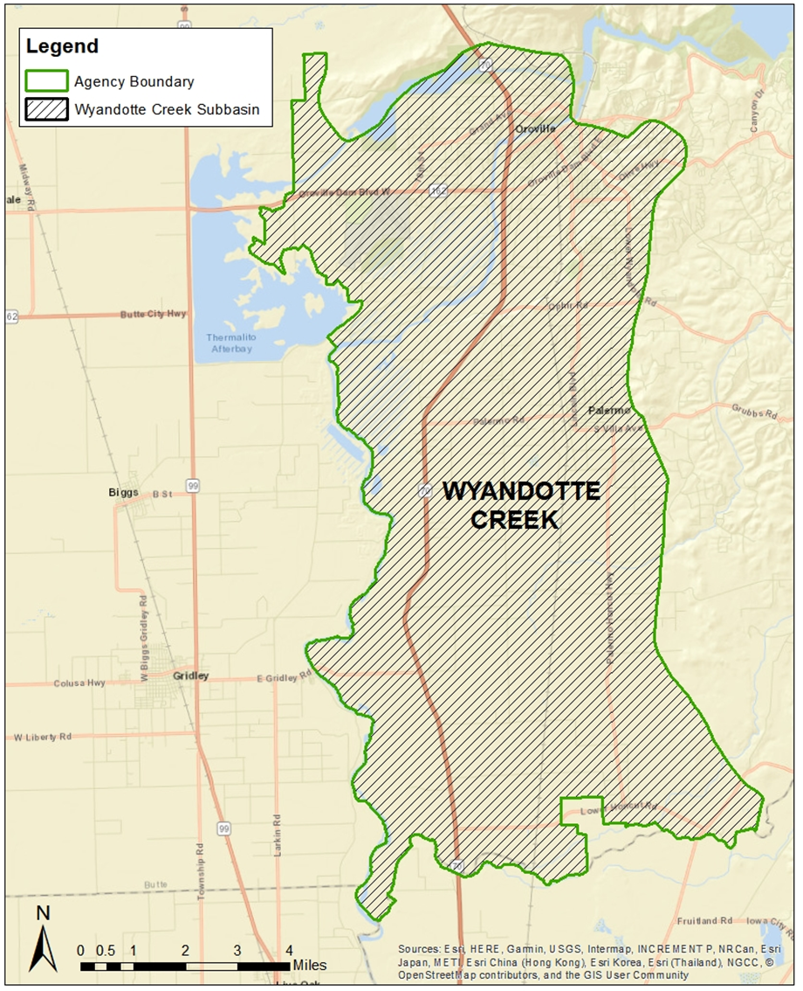
Groundwater Sustainability Plan Status
April 1, 2021

Slide 2
Groundwater Sustainability Plan Status
Groundwater Sustainability Plan
1. Administrative Information
§354.4. General Information
§354.6. Agency Information
§354.8. Description of Plan Area
§354.10. Notice & Communication
2. Basin Setting
§354.14. Hydrogeologic Conceptual Model
§354.16. Groundwater Conditions
§354.18. Water Budget
§354.20. Management Areas
3. Sustainable Management Criteria
§354.24. Sustainability Goal
§354.26. Undesirable Results
§354.28. Minimum Thresholds
§354.30. Measurable Objectives
4. Monitoring Networks
§354.34. Monitoring Network
§354.36. Representative Monitoring
§354.38. Assessment & Improvement
§354.40. Reporting Monitoring Data to the Department
5. Projects and Management Actions
§354.44. Projects & Management Actions

Slide 3
Groundwater Sustainability Plan Status
Schedule
Basin Setting Chapter – draft completed
Groundwater Dependent Ecosystems
Sustainable Management Criteria & Representative Monitoring Network Chapters
April – 30 day public comment period
May – Water Advisory Committee Review
June – Board consideration approve the final draft

Slide 4
Groundwater Sustainability Plan Status
Schedule
Projects and Management Actions
Current - Solicitation of potential projects and management actions
May – Review by Water Advisory Committee
May – Status provided to the Board
June – Board Public Workshop meeting & 30-day public comment period
July – Review of comments by Water Advisory Committee
July/August – Board consideration to approve final draft

Slide 5
Groundwater Sustainability Plan Status
Schedule
Implementation Chapter
May – Water Advisory Committee discuss implementation costs and approach
June – 30-day public comment period on the draft Implementation chapter
July – Water Advisory Committee review of public comments and recommendation to the Board
July/August – Board consideration to approve final draft

Slide 6
Groundwater Sustainability Plan Status
Schedule
Draft Groundwater Sustainability Plan (complete)
September – 60 day public comment period
November – Review of comments by the Water Advisory Committee and recommendations to the Board
Groundwater Sustainability Plan Approval & Implementation
December – Board hearings and approval
January – GSP Submission
January – Groundwater Sustainability Plan Implementation Grant

Slide 7
Groundwater Sustainability Plan Status
Thank you

